Slide 1
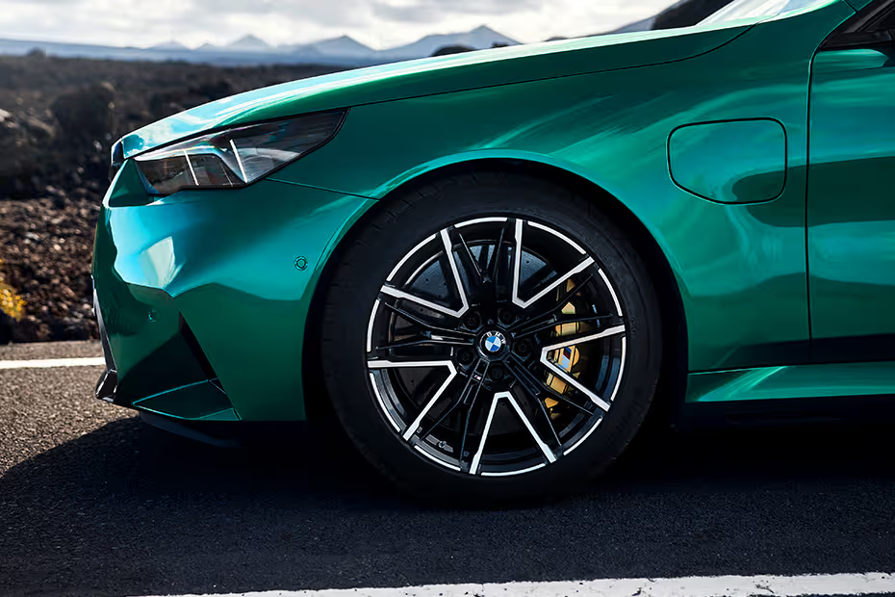

BMW Car Sales Analysis
MySQL – Driven Automotive Market Insights
Project Overview:
Comprehensive analysis of BMW car sales data using advanced SQL and Python techniques to uncover pricing trends, performance insights, and fuel-type distributions for strategic business decisions.
BY SUPRATIM MAITY

Slide 2

Dataset Overview
The dataset contains detailed sales information about BMW cars, including model, price, year, fuel type, mileage, and engine size.
Key Details:
• Total Records: 10781
• Total Columns: 9
• Columns Include: Model, Year, Price, Transmission, Mileage, Fuel Type, Tax, MPG, Engine Size

Slide 3
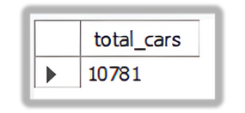
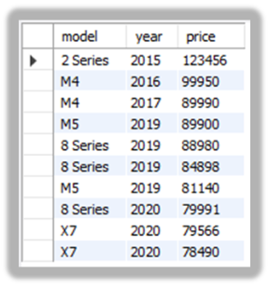
Business Problem & SQL Analysis
-- 1. Total number of cars in the dataset
OUTPUT -->
SELECT COUNT(*) AS total_cars FROM bmw_cars;
-- 2. Display top 10 most expensive cars
SELECT model, year, price
FROM bmw_cars
ORDER BY price DESC
LIMIT 10;
OUTPUT -->

Slide 4
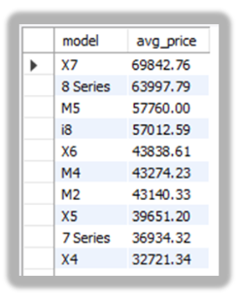
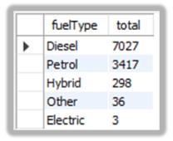
-- 3. Find the average price per model
SELECT model, ROUND(AVG(price),2) AS avg_price
FROM bmw_cars
GROUP BY model
ORDER BY avg_price DESC;
OUTPUT -->
-- 4. Count total cars grouped by fuel type
SELECT fuelType, COUNT(*) AS total
FROM bmw_cars
GROUP BY fuelType
ORDER BY total DESC;
OUTPUT -->

Slide 5
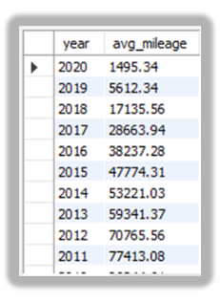
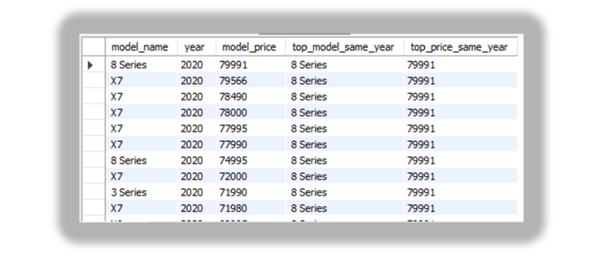
-- 5. Calculate average mileage per year
SELECT year, ROUND(AVG(mileage),2) AS avg_mileage
FROM bmw_cars
GROUP BY year
ORDER BY year DESC;
OUTPUT -->
-- 6. Compare each model’s price to the highest priced model in the same year
SELECT a.model model_name, a.year, a.price model_price, b.model top_model_same_year, b.price top_price_same_year
FROM bmw_cars a
JOIN (SELECT year, MAX(price) max_price FROM bmw_cars GROUP BY year) m ON a.year=m.year
JOIN bmw_cars b ON b.year=m.year AND b.price=m.max_price
ORDER BY a.year DESC, a.price DESC;
OUTPUT -->

Slide 6
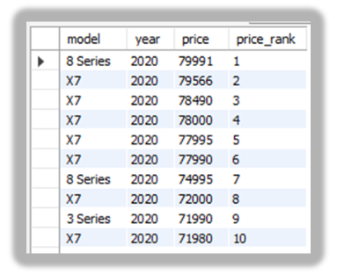
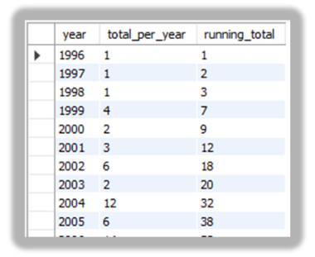
Contact
-- 7. Rank models by price within each year
SELECT model,
year,
price,
RANK() OVER (PARTITION BY year ORDER BY price DESC) AS price_rank
FROM bmw_cars
ORDER BY year DESC, price_rank;
OUTPUT -->
-- 8. Calculate running total of cars over the years
SELECT year,
COUNT(*) AS total_per_year,
SUM(COUNT(*)) OVER (ORDER BY year) AS running_total
FROM bmw_cars
GROUP BY year
ORDER BY year;
OUTPUT -->

Slide 7
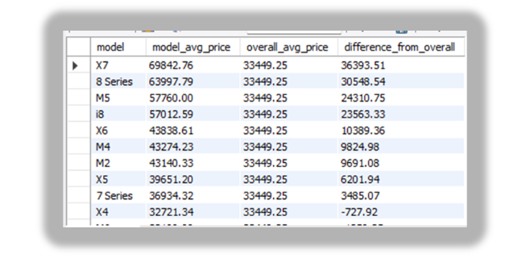
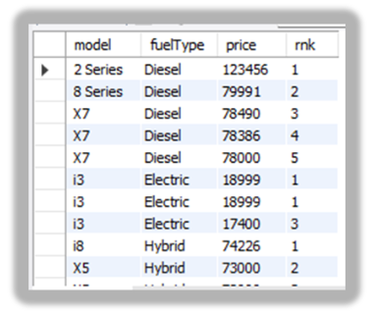
-- 9. Find average price per model and compare with overall average
OUTPUT -->
SELECT model,
ROUND(AVG(price),2) AS model_avg_price,
ROUND(AVG(AVG(price)) OVER (),2) AS overall_avg_price,
ROUND(AVG(price) - AVG(AVG(price)) OVER (),2) AS difference_from_overall
FROM bmw_cars
GROUP BY model
ORDER BY model_avg_price DESC;
-- 10. Get top 5 most expensive cars per fuel type
OUTPUT -->
SELECT model,fuelType,price,rnk
FROM (SELECT model,fuelType,price,
RANK() OVER(PARTITION BY fuelType ORDER BY price DESC) rnk
FROM bmw_cars) ranked
WHERE rnk<=5
ORDER BY fuelType,rnk;

Slide 8
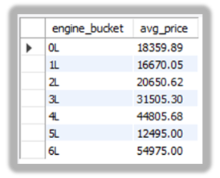
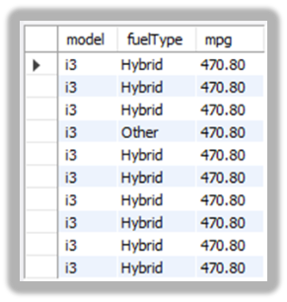
-- 11. Check how average price varies with engine size bucket
SELECT engine_bucket,
ROUND(AVG(price), 2) AS avg_price
FROM (
SELECT CONCAT(FLOOR(engineSize), 'L') AS engine_bucket,
price
FROM bmw_cars
) AS t
GROUP BY engine_bucket
ORDER BY CAST(REPLACE(engine_bucket, 'L', '') AS UNSIGNED);
OUTPUT -->
-- 12. Top 10 most fuel-efficient models
SELECT model,fuelType,mpg
FROM bmw_cars
ORDER BY mpg DESC
LIMIT 10;
OUTPUT -->

Slide 9
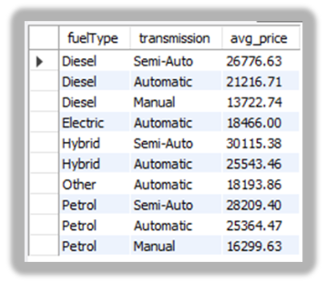
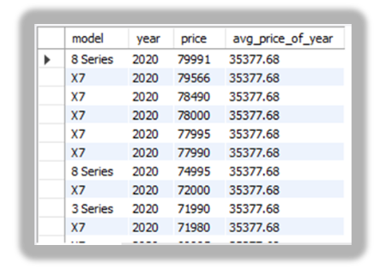
-- 13. Compare average price across transmission types per fuel type
OUTPUT -->
SELECT fuelType,
transmission,
ROUND(AVG(price), 2) AS avg_price
FROM bmw_cars
GROUP BY fuelType, transmission
ORDER BY fuelType, avg_price DESC;
-- 14. Models priced above the yearly average
OUTPUT -->
SELECT model, year, price, ROUND(year_avg,2) avg_price_of_year
FROM (
SELECT model, year, price,
AVG(price) OVER(PARTITION BY year) year_avg
FROM bmw_cars
) t
WHERE price > year_avg
ORDER BY year DESC, price DESC;

Slide 10
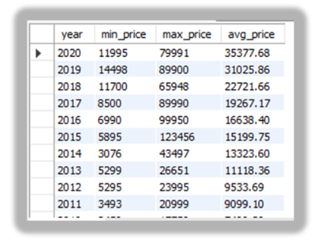
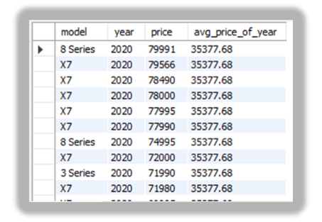
-- 15. Price distribution per year
SELECT year,
MIN(price) AS min_price,
MAX(price) AS max_price,
ROUND(AVG(price), 2) AS avg_price
FROM bmw_cars
GROUP BY year
ORDER BY year DESC;
OUTPUT -->
-- 16. Outlier detection: cars priced 1.5x above yearly average
OUTPUT -->
SELECT model, year, price, ROUND(year_avg,2) avg_price_of_year
FROM (
SELECT model, year, price,
AVG(price) OVER(PARTITION BY year) year_avg
FROM bmw_cars
) t
WHERE price > 1.5*year_avg
ORDER BY year DESC, price DESC;

Slide 11

Key Insights &
Recommendations
Key Insights:-
BMW dataset shows a diverse range of models across multiple years, with increasing listings in recent years.
Premium models (M-series, X-series) command the highest average prices, while entry models remain budget-friendly.
Petrol cars dominate, but diesel and hybrid variants show strong fuel efficiency.
Larger engines (3.0L+) and automatic transmissions are associated with higher prices.
Average prices have risen over the years; some models remain priced well above yearly averages, showing strong market demand. Outlier cars priced 1.5× above yearly averages are performance or luxury editions.
Recommendations:-
Pricing: Use yearly and model-wise averages to set competitive resale prices and identify over/underpriced cars.
Inventory Focus: Prioritize high-demand models (e.g., M-series, X5) and expand hybrid/electric stock.
Marketing: Promote fuel-efficient diesel/hybrid models and premium performance models for niche buyers.
Data Strategy: Track price vs. mileage and engine size trends for smarter forecasting.
Future Work: Add depreciation and regional analysis to refine pricing insights.

Slide 12
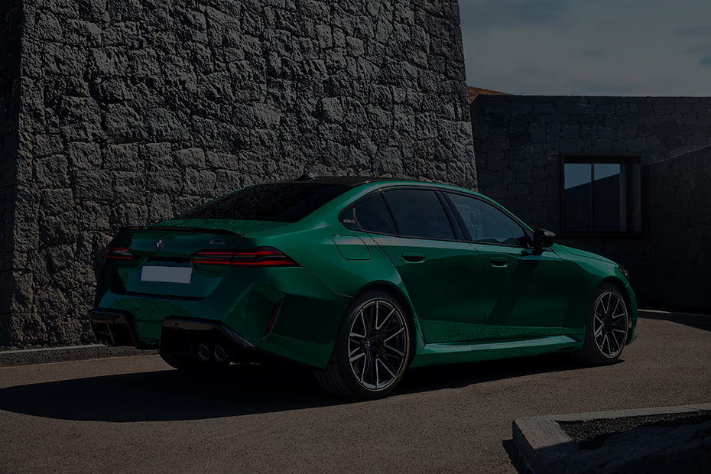

Thank You.

